Slide 1

------------
Intrusion Detection System
using
Convolutional Neural Network
Presented By:
Name: Ishita Srivastava
Section: B Roll No.: 30
University Roll No.: 2018845

Slide 2


Intrusion Detection System
An IDS(Intrusion Detection System) is a device or software application that monitors a network or system for malicious activity or policy violations.
Intrusion Detection System
An IDS(Intrusion Detection System) is a device or software application that monitors a network or systems for malicious activity or policy violations.
An intrusion activity or violation is typically reported either to an administrator or collected centrally using a security information and event management system.

Slide 3

Convolutional Neural Network
A 1D CNN is like a smart system designed to understand patterns in a given data sequence.
It’s like a detective system that learns from your data in a smart way focusing on small pieces, finding patterns, and summarizing information to understand the entire sequence better.

Slide 4
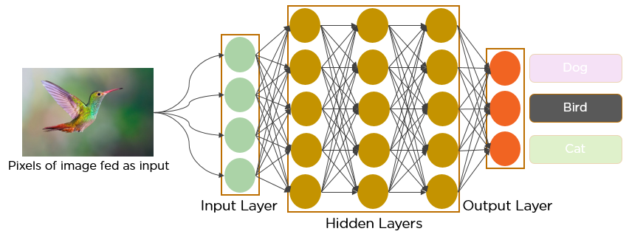
Working of CNN

Slide 5
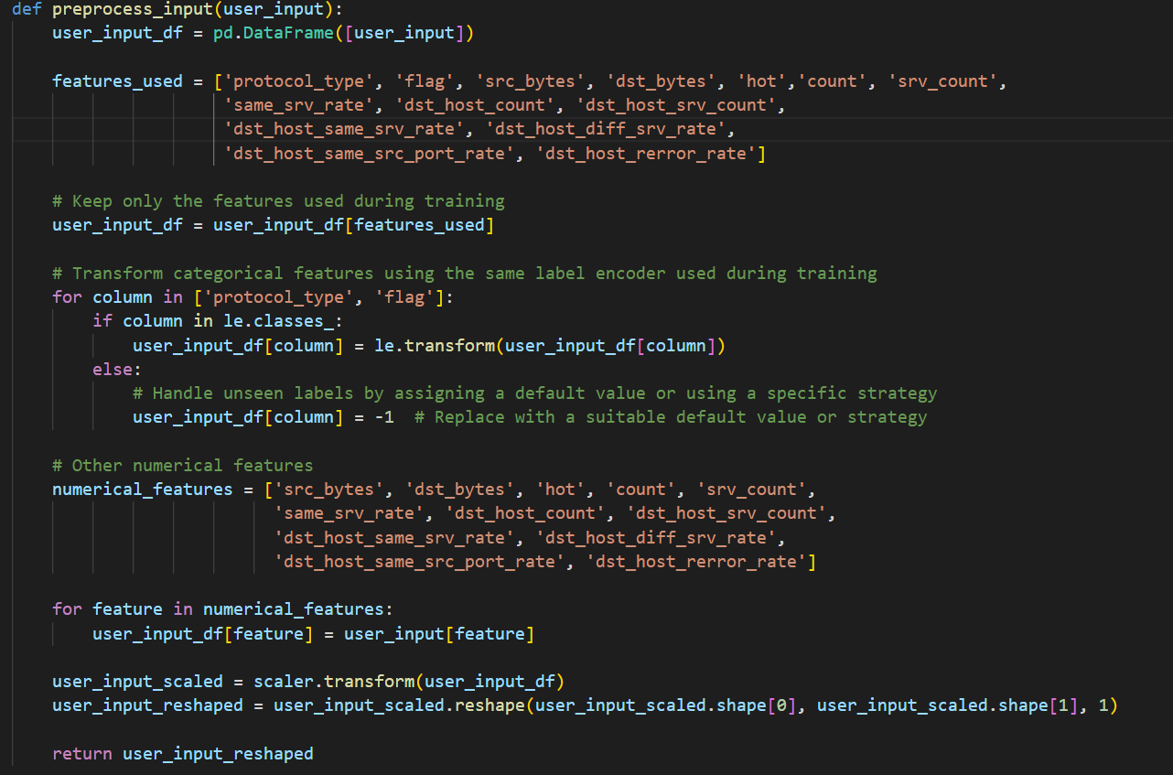
Data
Pre-Processing
The following code-snippet is of pre-processing the data, given by the user before predicting whether there is an anomaly or not.
Data pre-processing is crucial as you don’t want the system to just memorize your data; you want it to understand and learn.

Slide 6
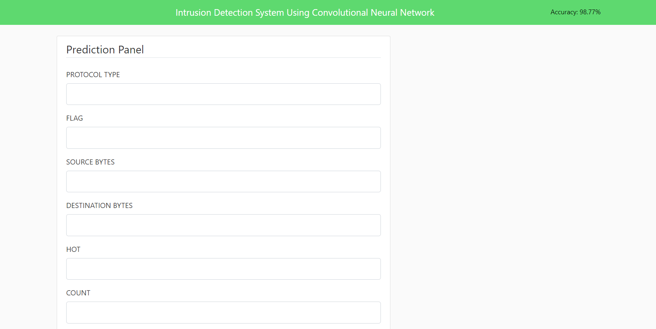
Result
Using flask framework generated API, we can positively run our program.
It gives an accuracy of approx.
~ 98.5%. We can also test the model for a random user input, thus predicting whether there is an anomaly or not.

Slide 7
Thank you!

